Slide 1
Study of a non-Catalytic Gas-Solid Reaction by Thermo-gravimetric Technique
Presented by
Dr. Bhaskar Bhaduri

Slide 2
Objective:
To determine conversion, reaction rate constant for the decomposition of sodium bicarbonate pellets
To calculate activation energy in the temperature range of 100- 200 ºC
Chemical reaction under consideration:
2NaHCO₃ = Na₂CO₃ + CO₂+ H₂O
Generally, we perform the decomposition reaction at three different temperatures, namely, 120ºC, 140ºC, and 160ºC.

Slide 3
Theory
The rate of decomposition of NaHCO₃ can be represented as:
R_{o}d₀f = kt …………………. (1)
Where,
R_{o} is the initial radius of the pellet (cm)
d_{o} is the density of reacting pellet (gm/cc)
t is the reaction time (min)
k is the reaction rate constant
f is a dimensionless factor which represents the fractional thickness of the reacted solid at any instance
For cylindrical pellet with any ratio of length/diameter, reaction conversion X is given by:
X = 1- (a-f)(1-f)²/a ……………..(2)
Where, a = length to diameter ratio of the pellet
X= steady state conversion of NaHCO₃ at a particular temperature= delta W/ summation over delta w
delta w = w at(t=0)- w(t=t)

Slide 4
Apparatus required
An analytical weighing balance
Sample holder made up of 200 mesh SS screen
A wire carrying the sample holder
A tube furnace consisting of multiple tube of length 45.72 cm and a diameter of 5.08 cm. The furnace bottom is packed with quartz particles
A voltage stabilizer and control device to avoid the fluctuation in voltage and temperature

Slide 5
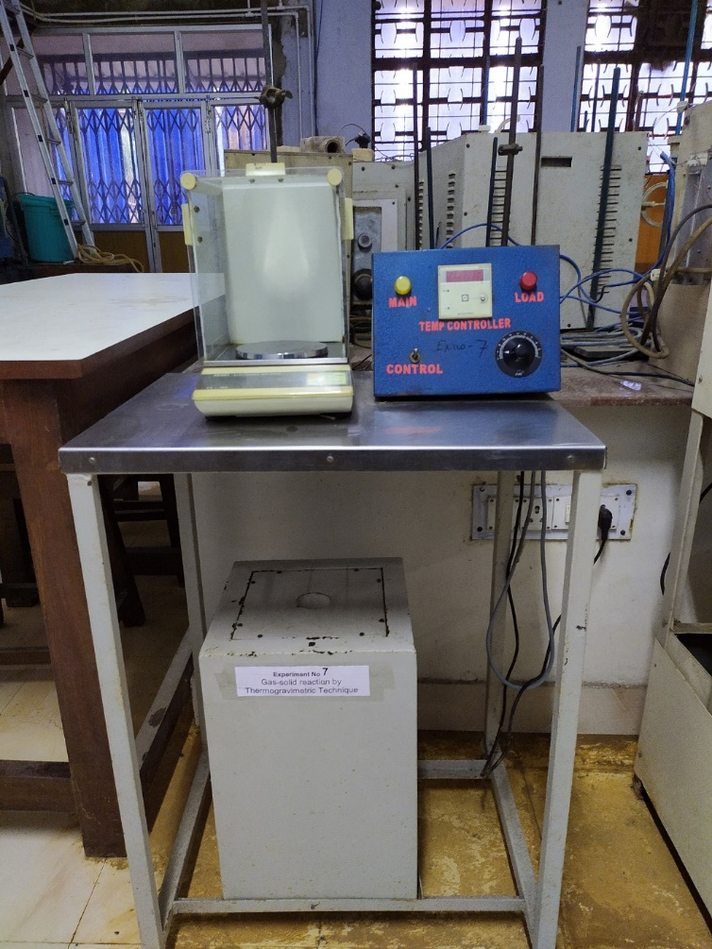
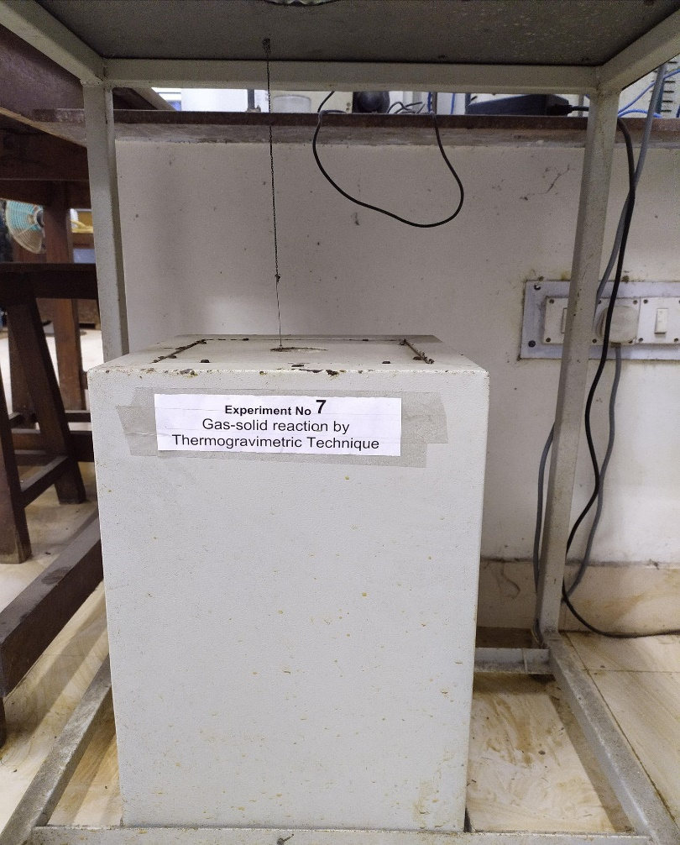
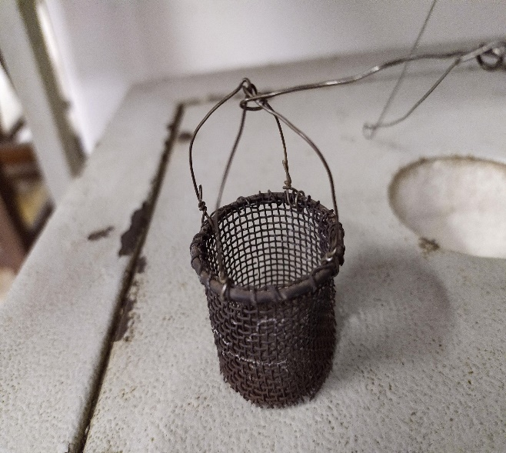
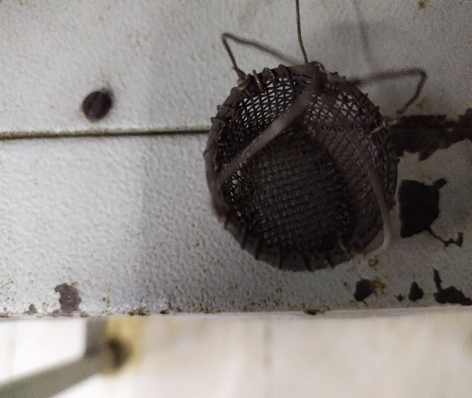
Experimental set-up
Without sample holder
With sample holder
Sample holder made up of SS mesh
1
2
3
Pt wire
4
Sample holder made up of SS mesh

Slide 6
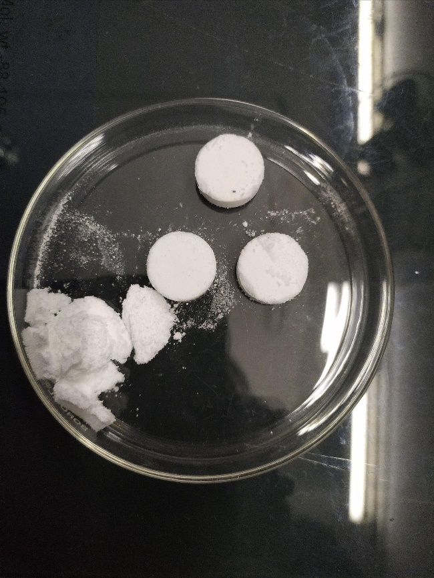
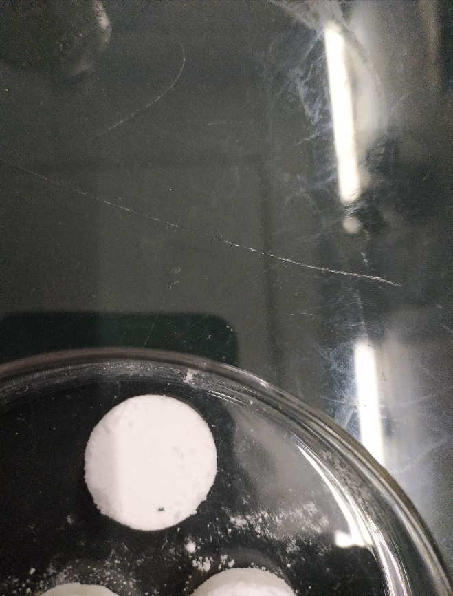
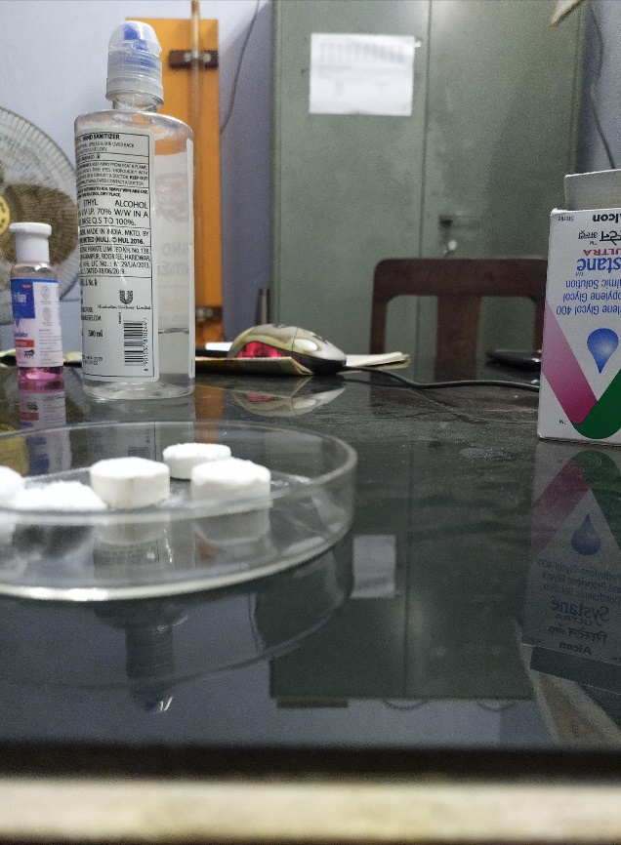
Images of cylindrical pellets
NaHCO₃ pellets

Slide 7
Results (Calculations)
S.N. | Time (min) | Weight (w) of the pellet (g) | Delta w = w (t=o)-w (t=t) | X=delta w/summation over delta w | f | R_{o}*d_{o}*f
1 | 0 | Initial weight of the pellet in g (before exposing the pellet to high temperature inside the furnace) | NA
2 | 1 |  | .
3 | 2 |  | .
4 | 3 |  | .
4 | 4 |  | .
6 | 5 |  | .
7 | 6 |  | .

Slide 8
Steps to calculate the reaction rate constant, activation energy of the decomposition reaction
Step 1: Plot r_{o}*d_{o}*f ( y axis) vs time (x axis) at each reaction temperature. A straight line would be obtained. The slope of the straight line would give us the value of reaction rate constant.
Step 2: Activation energy of the reaction would be obtained based on Arrhenius equation.

Slide 9
Thank you

